Slide 1


SD Companies Analysis
By Shivam Deshmukh

Slide 2
Introduction
SD Companies have decided to analyze their company’s performance of past years so here we have their 4 year data
of sales and profit.
Our aim is to analyze the entire data using Tableau Software and create a Interactive Dashboard.

Slide 3
About Data
Data Source of the project :
https://www.kaggle.com/lenapiter/sales-data
Main Problem Statement of the project : My aim is to analyze the data and create a interactive dashboard using this data

Slide 4
Understanding the Data
Data consist of : 20 columns and 9994 rows
The data consist of the information about company (like Sales, Profit, Category, Sub-Category, Order Date, Region, etc).

Slide 5
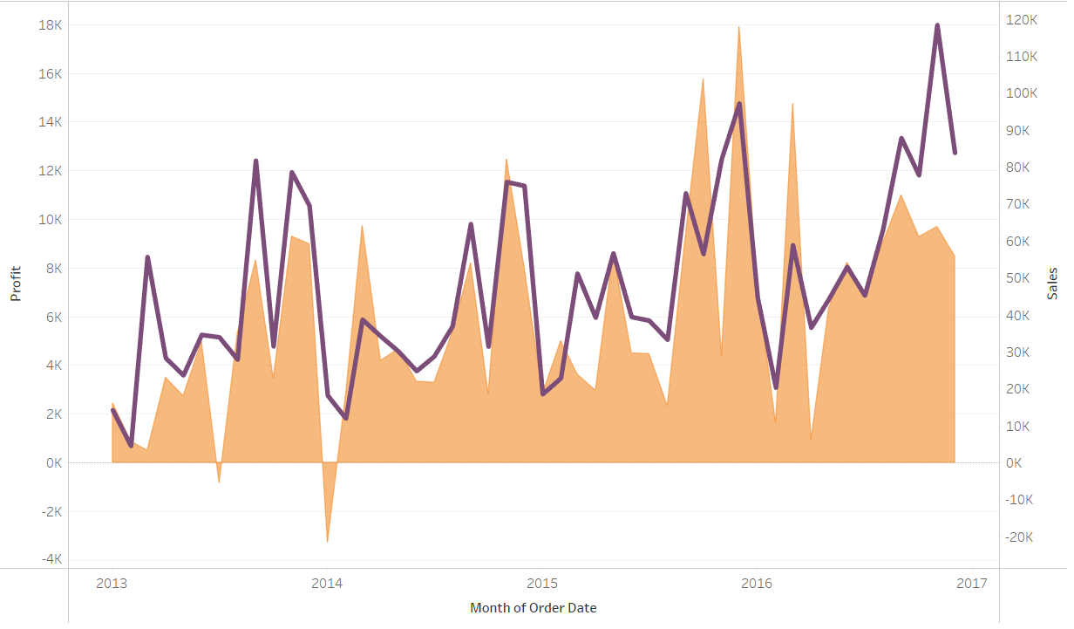
Basic Analysis of Data

Slide 6
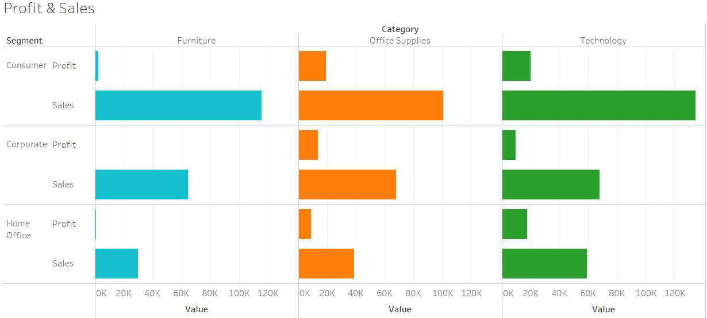

Slide 7


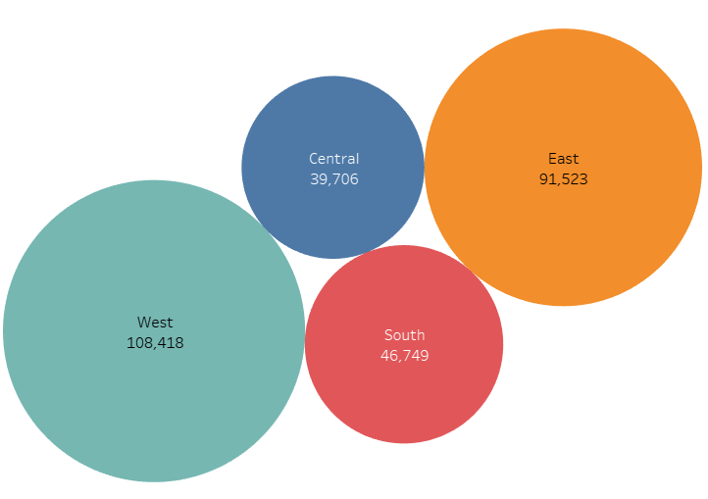
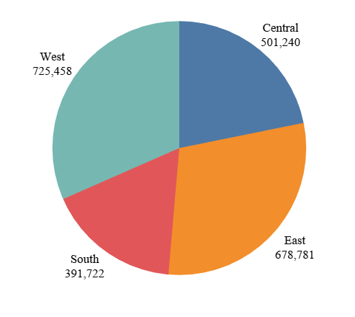

Slide 8
Analysis Result
The result of analysis of the SD Companies Data is pretty good. The whole data is been studied and properly analyzed. We are able to visualize the data in different forms (like Bar chart, line charts, pie charts, etc.
I’m able to create a Dashboard which properly explains the relationship between all the factors and properly displays them in the form of Dashboard and Story.

Slide 9
Conclusion
I have successfully created a dashboard by analyzing the data and visualizing it using Tableau Software.
I have gone through most of the features of Tableau while working on the data.

Slide 10
My Project Analysis
Drive link :
https://drive.google.com/drive/u/0/folders/11_RvgrR_1twJPCmoEgvcxbb8k3ITk8T7
Content of Drive :
1. Tableau File
2. Presentation Report
3. Explanation Video

Slide 11

Thank You

